Slide 1
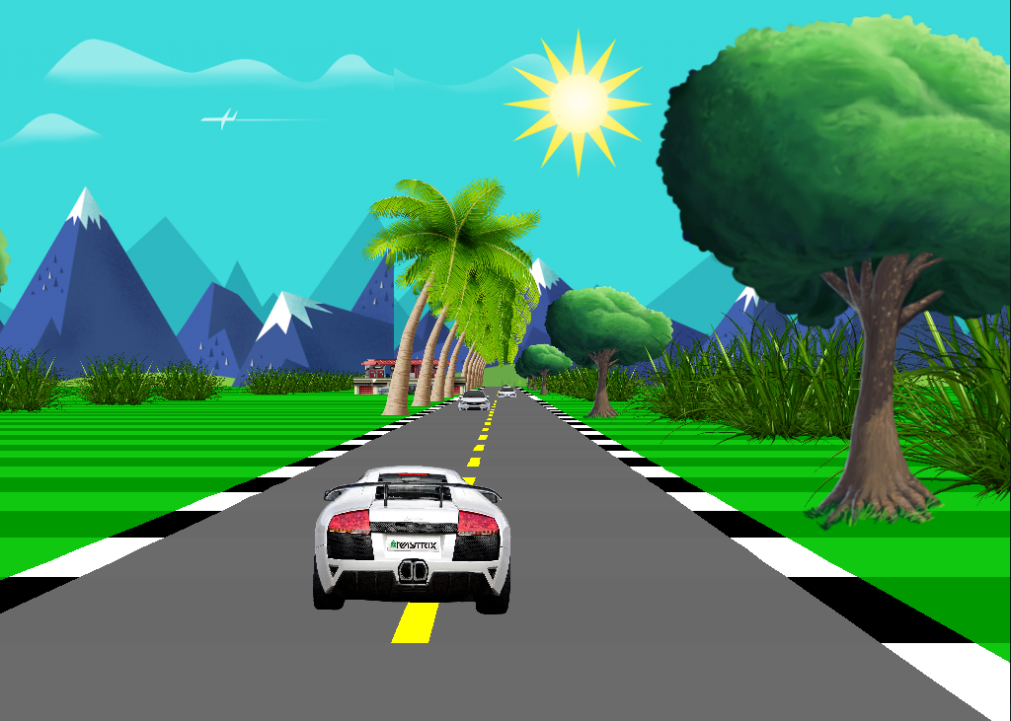
Car Race
Project by : Subash kc

Slide 2
About game
This is sample car race game.
Made by using SFML(simple and fast multimedia library)
SFML is based in OpenGL.

Slide 3
How SFML Work?
A typical game loop has three main stages:
Input handling
The update frame
The render frame

Slide 4
Textures are quite simple objects.
sprite is a surface with a texture on it.

Slide 5
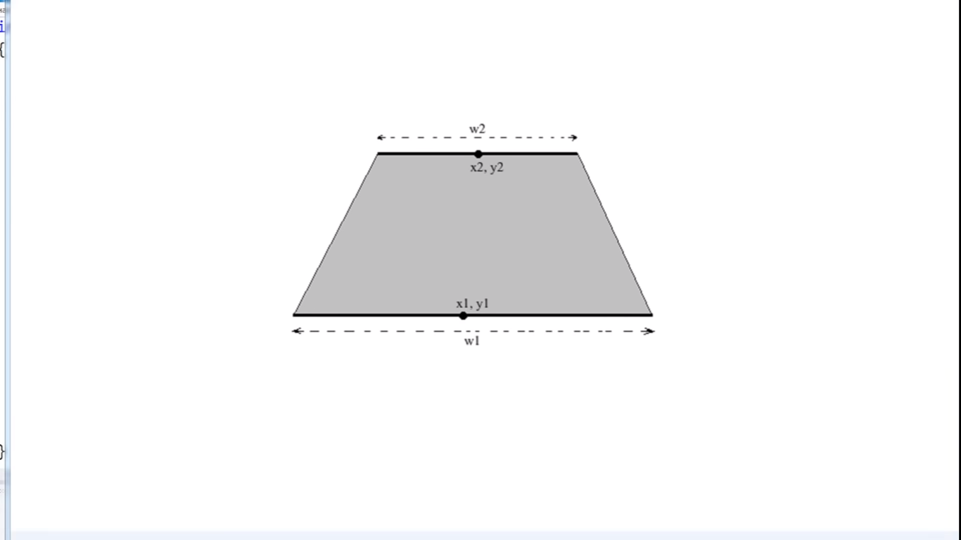
Road

Slide 6
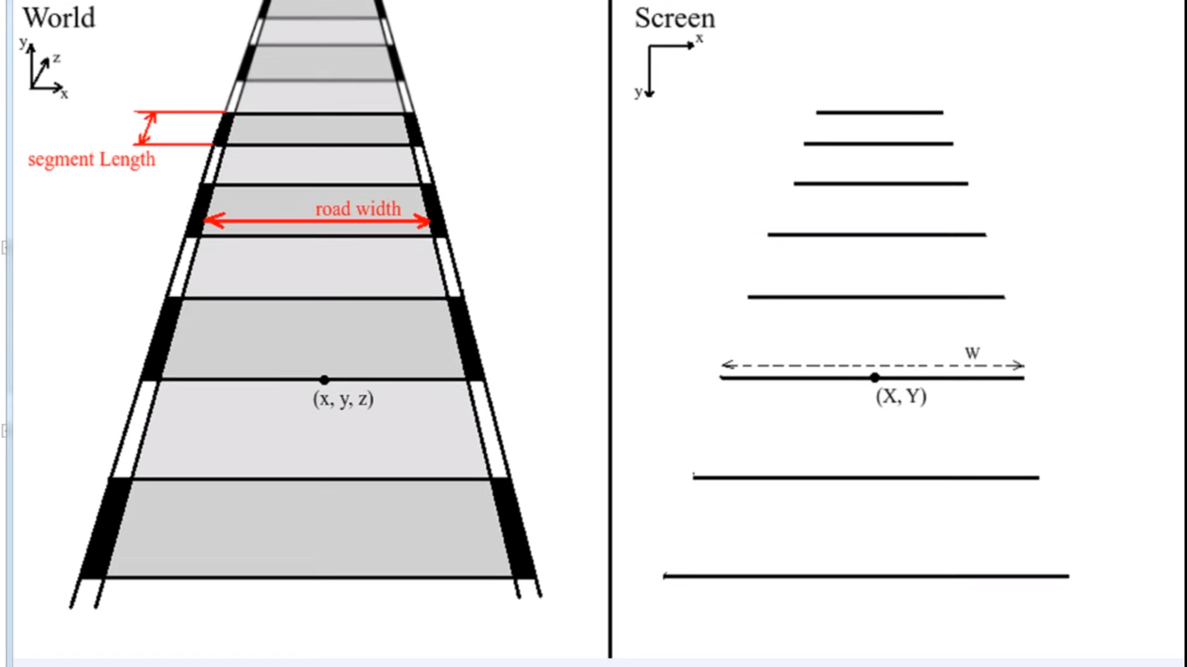
Road in 3D

Slide 7
road are moving but car is not moving.
car appear smaller in far then with the increasment of z-axis, its size increases.
car move left and right , by increasing right and left cordinate i.e y-axis.

Slide 8
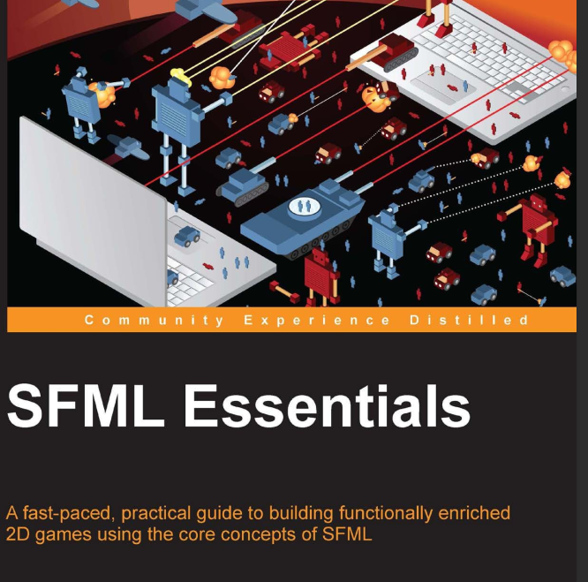
Reference

Slide 9
Demonstration

